Slide 1
Supporting Teachers’ Learning Needs in the Era of Next Gen Science
Carla Zembal-Saul, Ph.D.
Kahn Professor of STEM Education
NSTA Fellow

Slide 3
What do you notice about
...the role of teacher inquiry?
...the ways in which working across the professional continuum is addressed?
...how we learn from and through practice?
...how practice is made public?
...the features of a supportive environment?

Slide 4
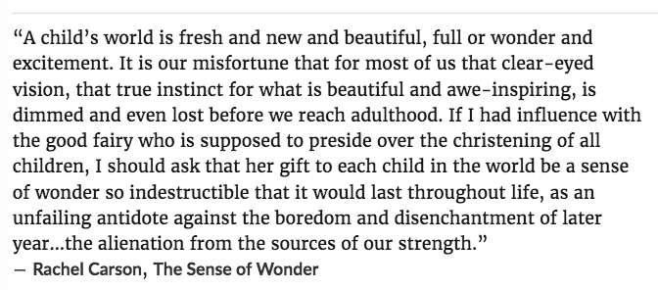
Sense of Wonder (as source of strength)

Slide 5
Essential Features of the Framework
EQUITY – Science for ALL students!
Three Dimensional Science Learning
Scientific and engineering practices
Crosscutting concepts
Disciplinary core ideas
Phenomena-based and full of wonder
Coherent learning progressions
*Young children are capable of this kind of science learning!

Slide 6
Making the Shift to NGSS
Focusing on science content TO engaging in 3D learning
Facts → Big Ideas
Skills → Scientific & Engineering Practices
Discrete Focus → Coherent Ways of Understanding Science
Prioritizing science topics TO productive participation with phenomena-based, question-driven science
Doing hands-on science (e.g., “activity-mania,” “snacks and crafts”) TO…
Arguing from evidence, constructing evidence-based explanations, modeling
Coherent and consequential sequence of learning opportunities

Slide 7
The Disconnect
There is a gap between the new vision for science learning and current instruction, curriculum, and assessment.
Across the nation, it is likely that teachers…
Have not experienced this kind of science learning
Have not been prepared to teach in ways that reflect the new vision
Teach in districts that focus on and support subjects other than science (i.e., literacy and numeracy)

Slide 8
The new vision for science education renders ALL of us novice in some way.

Slide 9
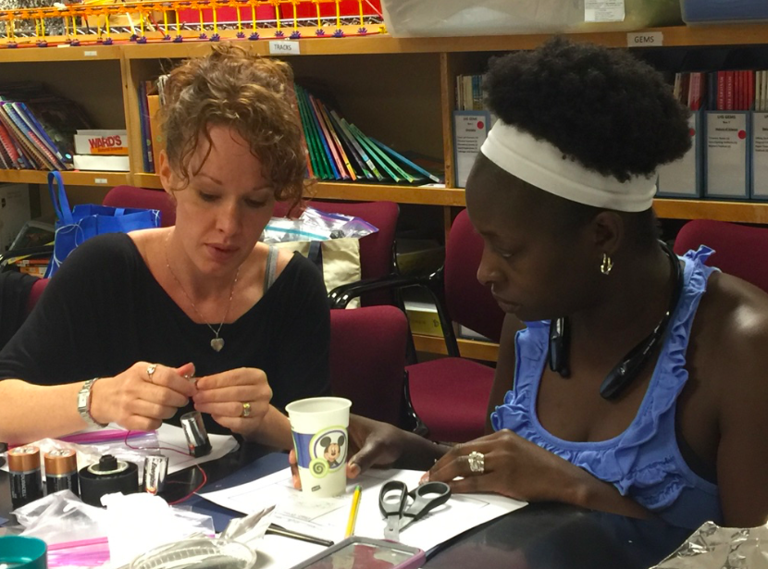
How do we support teachers
in making these ambitious shifts to support students’ meaningful science learning and scientific practice?

Slide 10
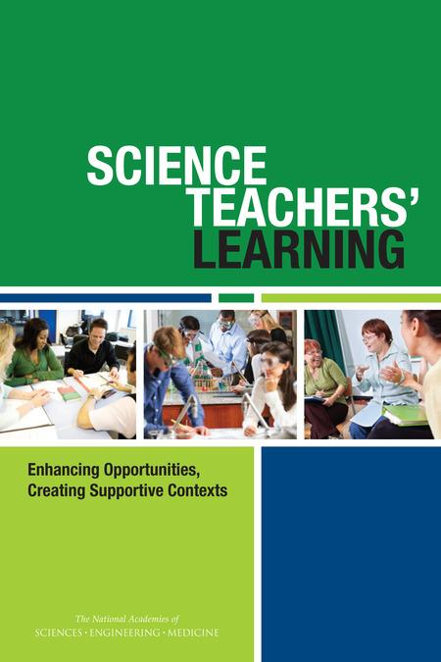
Science Teachers’ Learning:
Enhancing Opportunities, Creating Supportive Contexts
The National Academies of Science • Engineering •Medicine
Board on Science Education
in collaboration with Teacher Advisory Council
with funding from Merck Company Foundation

Slide 11
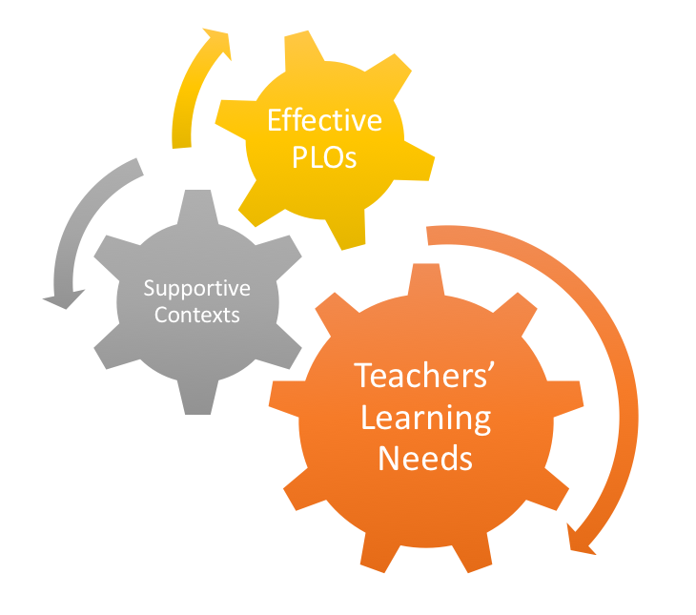
Professional Learning Opportunities
Main Areas
of the Report

Slide 12
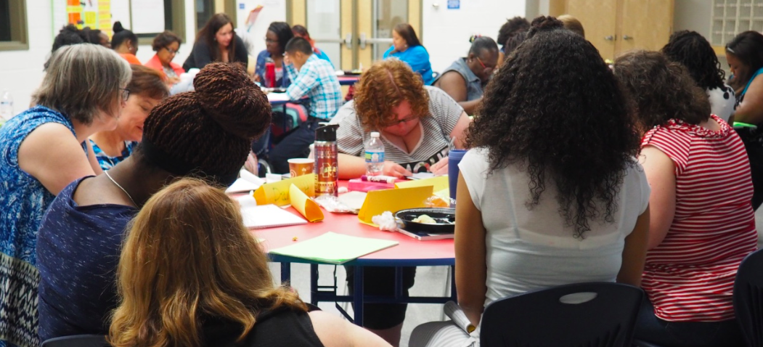
Who are today’s teachers and
what does that mean for designing
professional learning opportunities?

Slide 13
A National Snapshot
Characterized by substantial variability
Background and preparation
Professional learning opportunities
Contexts in which they work
Available data
Fragmented across surveys
Difficult to access and make sense of survey data on PD for elementary teachers
Notes:
2012 National Survey of Science and Mathematics Education
SASS 2007-08 (NCES Schools and Staffing Survey)
Commissioned reports – administrative databases in Florida and New York

Slide 14
Notable National Trends
Science teaching career
40% middle school and ~50% high school science teachers have >10 years experience
More than half of new science teachers leave before 5th year
Science background – no science cert
40% of middle level science teachers
14% high school science teachers
Notes:
Workforce becoming newer and less experienced

Slide 15
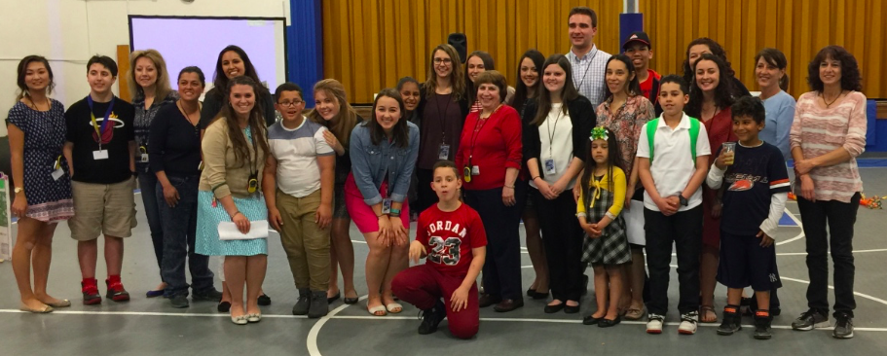
We must work intentionally
ACROSS the professional continuum.

Slide 16
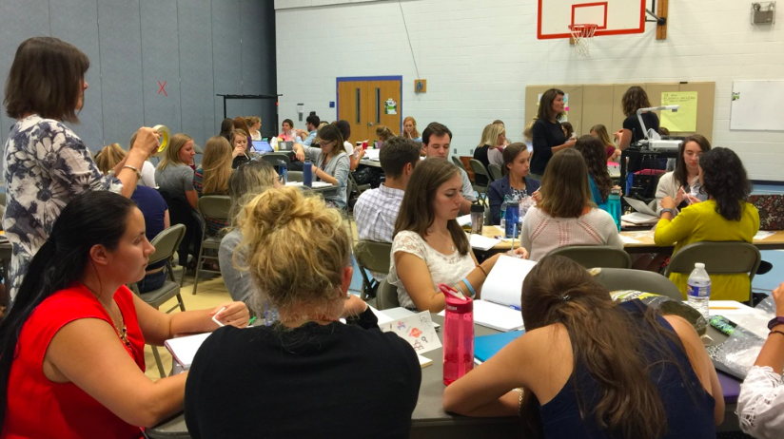
Professional Continuum
Career stage
Preservice
Early career
Experienced/veteran
System level
Elementary school
Middle school
High school
Higher education

Slide 17
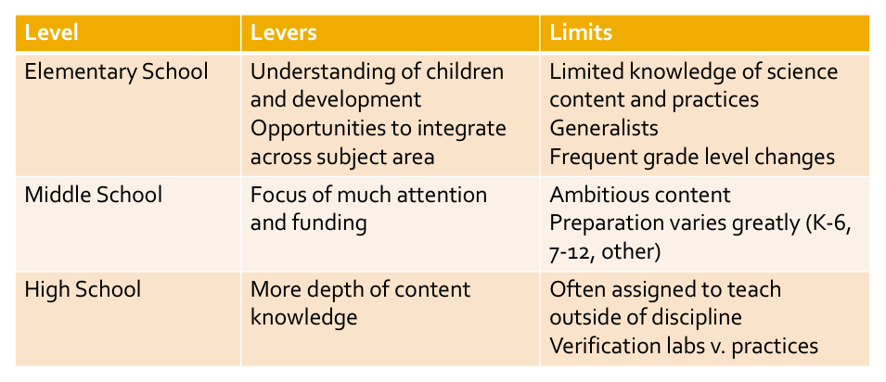
Focus on Levers

Slide 18
Professional Continuum Redefined
Continuum as essential expertise that teachers and groups of teachers develop across careers to meet the demands of the new vision.
Developmental and dynamic process
Context dependent
Responsive to problems of practice
Attentive to equity and ethics

Slide 19
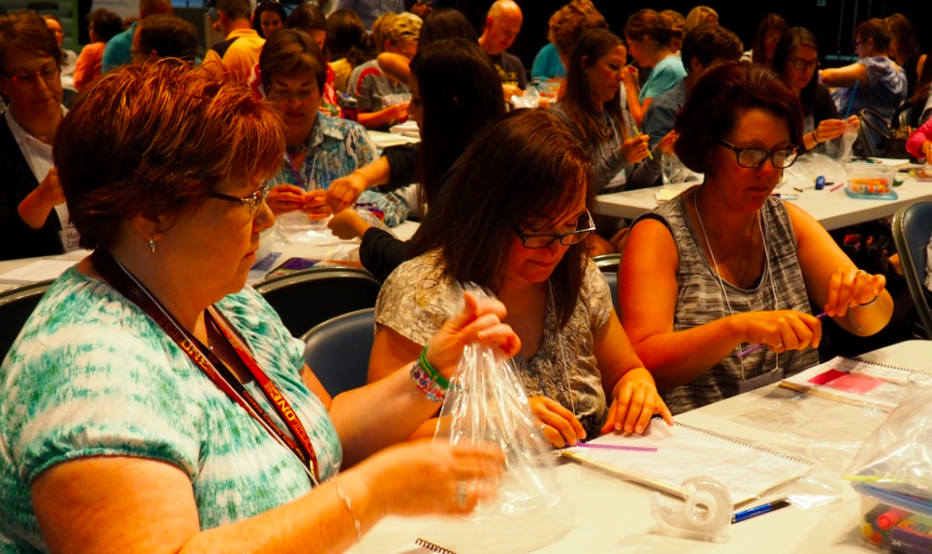
What do we know from the
research about effective
professional development?

Slide 20
Problematic Aspects of Current PLOs
Substantial variability in PLOs
Driven by individual interests without consideration of building capacity at the school or district level
Episodic and lack coherence (i.e., tiny pieces loosely connected)
Uninformed by articulated theory of learning
Fails to include teachers’ voices and focus on their problems of practice

Slide 21
Consensus View
Active participation of teachers who engage in analysis of examples of effective instruction and student work,
Content focused,
Alignment with district policies and practices, and
Sufficient duration to allow repeated practice and/or reflection on classroom experiences.
BOSE, 2015

Slide 22
And in light of the new vision...
Integrate three dimensions of science learning
Engage with scientific and engineering practices
Attend to meaningful assessment practices
Support all learners, including English learners and children who are differently abled, to be successful in science!

Slide 23
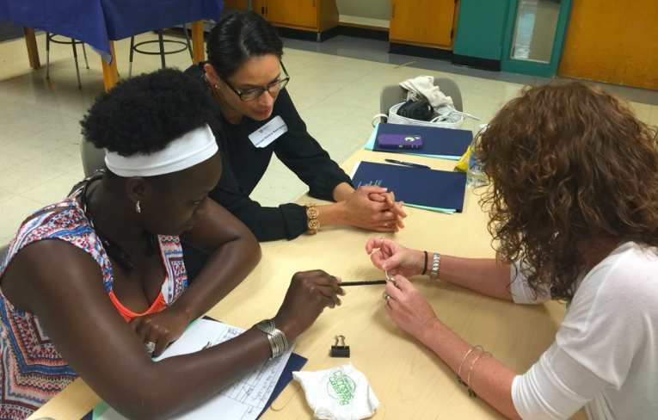
ALL teaching and learning is
context dependent!
What are considerations for
creating supportive contexts for
teacher learning in science?

Slide 24
The Big Picture
high stakes testing • rapidly changing demographics •
STEM college and career readiness

Slide 25
A Constellation of Supports Are Needed
Job embedded and inquiry-based
Across all levels of the professional continuum and educational system
In concert with school district administration, families and the community
Focus on capacity building and collaboration
Networks of expertise that include new voices and venues
Sensitivity to context
Genuine commitment to serve ALL children!
Notes:
Job embedded, coherent, focus on individual development and capacity building, teacher leadership and collaboration, involves administrators and community members

Slide 26
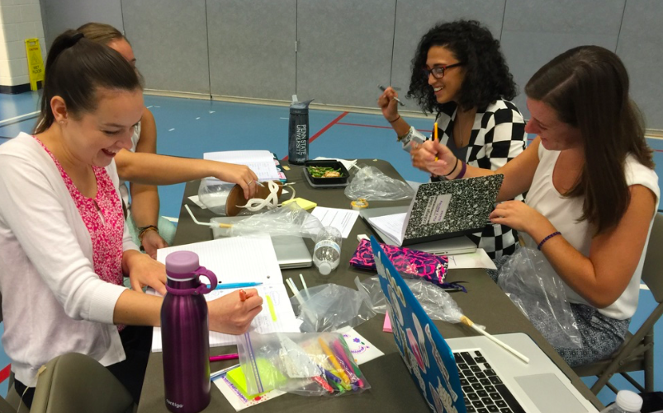
Learning from and through practice over time, in context, and with support
___________________
GOAL

Slide 27
Adopting an inquiry stance toward teaching and learning science
_____________________
VEHICLE

Slide 28
An Example:
State College Area School District
Penn State University
Professional Development School Partnership
Notes:
Sharon’s work AND...

Slide 29
What do you notice about...
...the role of teacher inquiry?
...the ways in which working across the professional continuum is addressed?
...how we learn from and through practice?
...how practice is made public?
...the features of a supportive environment?

Slide 30
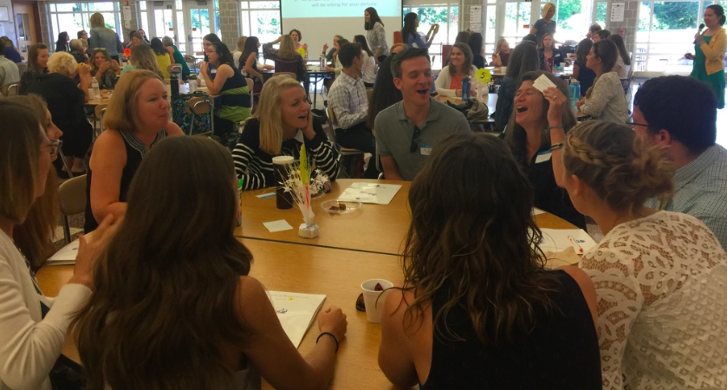
Practitioner Inquiry as
Signature Pedagogy

Slide 31
Features of the PDS
Commitment to simultaneous renewal; research and practice inform one another
Preservice teachers engaged in a year-long internship
Mentor teachers engaged in ongoing professional development and leadership roles (e.g., co-teaching methods courses with university faculty)
Administrative and curriculum support at all levels
Cultural norms that support learning from practice
Examining practice as something that effective professionals do
Making our practice and research public

Slide 32
Our Challenge:
To Change the Culture of the Profession

Slide 33
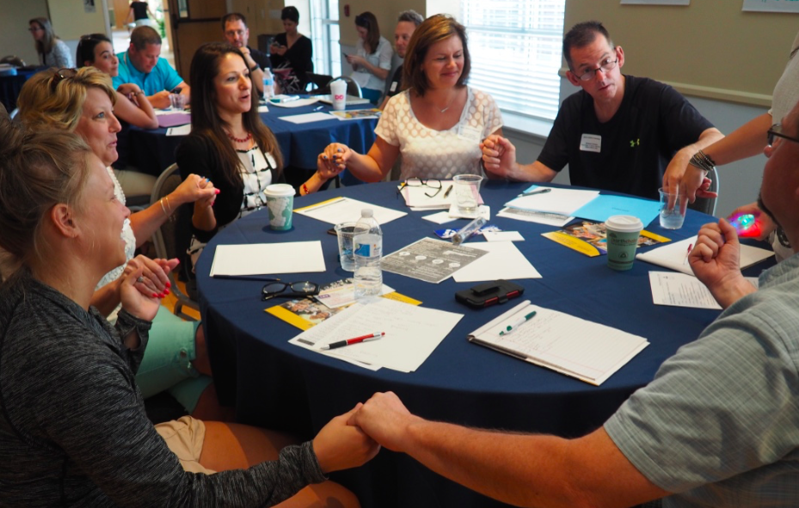
The Reward:
Rekindling Your Sense of Wonder
Revitalizing the Profession
Notes:
Disrupting negative narratives about the profession

Slide 34
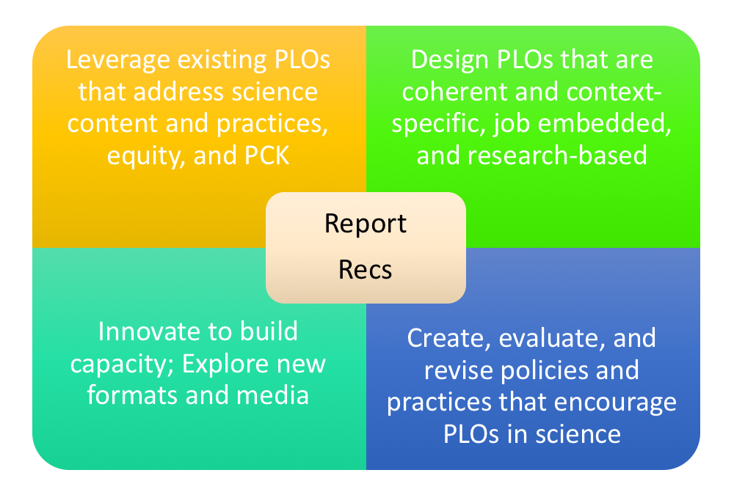

Slide 35
www.nap.edu
Notes:
Use the NRC report to leverage resources that support your ongoing learning as a professional

Slide 36
Educate • Inquire • Innovate • Inspire

Slide 37
My wish for you is that you are able to commit to the complex-problem solving work of 3D science teaching; that you nurture your students’ sense of wonder about how the world works; and that you find joy through engaging in your ongoing professional learning for years to come.
Notes:
Nurture the commitment to making teaching a joyful act that feeds our sense of wonder to support the learning of ALL children

Slide 38
Thank you and stay in touch!
Carla Zembal-Saul
Penn State University
czem@psu.edu

Slide 39
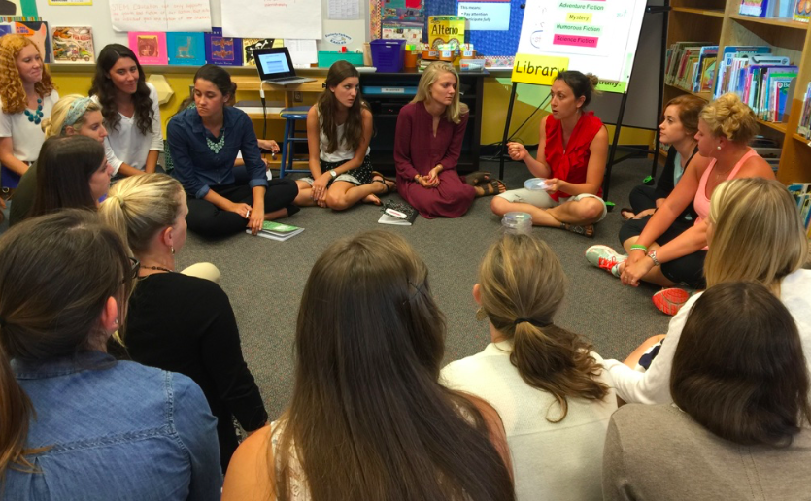
Discussion
Notes:
Questions

Slide 40
How are you thinking about:
...the role of teacher inquiry?
...the ways in which working across the professional continuum is addressed?
...how we learn from and through practice?
...how practice is made public?
...3D educative curriculum?
...the features of a supportive environment?

