Slide 1
Introducing Seven Valleys New Tech Academy
November, 2015

Slide 2
Seven Valleys is part of the Regional Vision

Slide 3
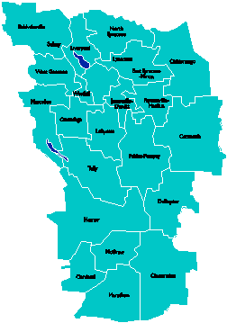
A Vision for Education in Central New York
College, Career & Citizenship Readiness
Notes:
Steve and Colleen

Slide 4
What if…
… all students were motivated?
… all students were engaged?
… all students could communicate? Collaborate? Think critically? Creatively solve problems?
… all students were ready for college and career?
Notes:
Steve and Colleen

Slide 5
What if…
… all employees were motivated?
… all employees were engaged?
… all employees could communicate? Collaborate? Think critically? Creatively solve problems?
… all employees were open to learning new things?
Notes:
Colleen and Steve

Slide 6
What does it REALLY mean to be College, Career & Citizenship ready?
READY
Notes:
Jeff

Slide 7
College Readiness in NY:
75%
ELA test
80%
Math test
Notes:
Jeff

Slide 8
Complementary Approaches
Career & Technical Education (CTE)
New Tech South
Junior and seniors attend half-day training program
CTE requirements met at BOCES; NYS requirements met at home school & BOCES
Internships/field experiences in the career of study, i.e. auto technology
Students learn a specific career-centered skill set
Students attend for four years, all-day
All NYS requirements met at the New Tech school
Internships/field experiences in a variety of settings as students explore potential careers
Students work on projects inspired by authentic business, government, and community ideas
Notes:
Colleen

Slide 9
High School of the Past
Knowledge
History
Biology
Chemistry
Physics
Math
Literacy
Economics
Government
Culture
Current events
Notes:
Nancy

Slide 10
High School of the Future
Skills
Collaboration
Critical thinking
Communication
Creativity
Problem solving
Technology
Literacy
Numeracy
Researching
Time management
Knowledge
History
Biology
Chemistry
Physics
Math
Literacy
Economics
Government
Culture
Current events
Attributes
Persistence
Resilience
Patience
Self-worth
Confidence
Adaptability
Curiosity
Flexibility
Risk taking
Responsibility
Agency
Notes:
Nancy

Slide 11
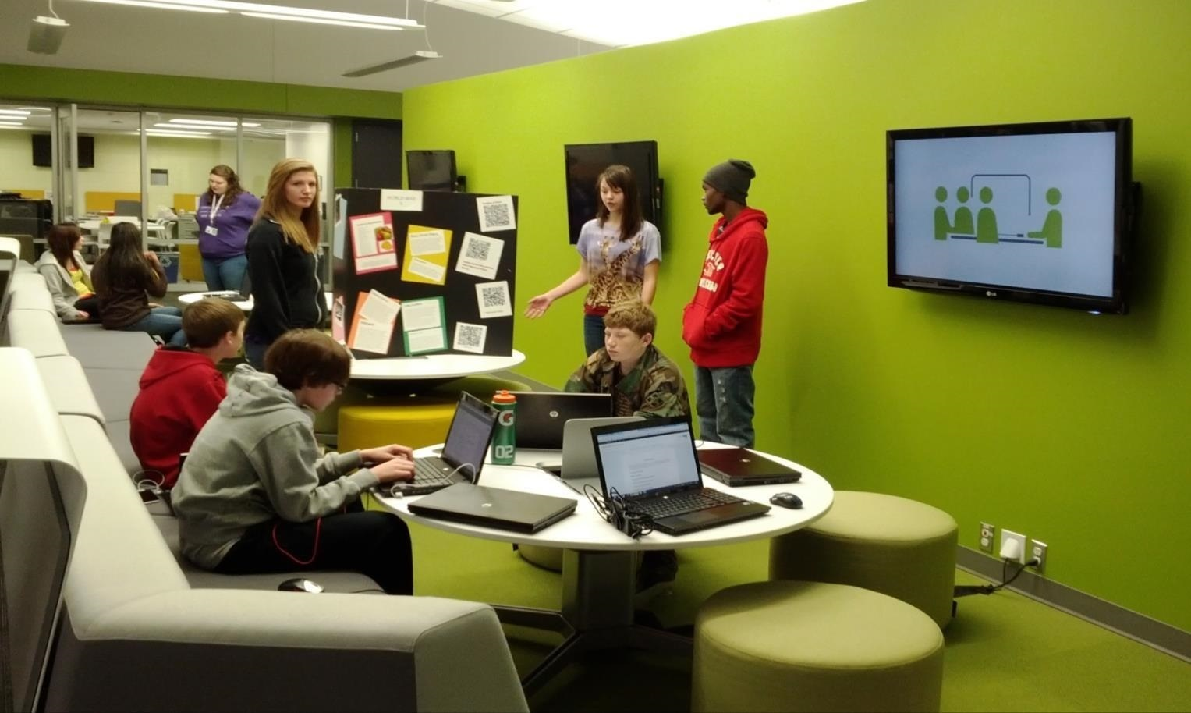
What Might that Look Like?
Notes:
Nancy

Slide 12
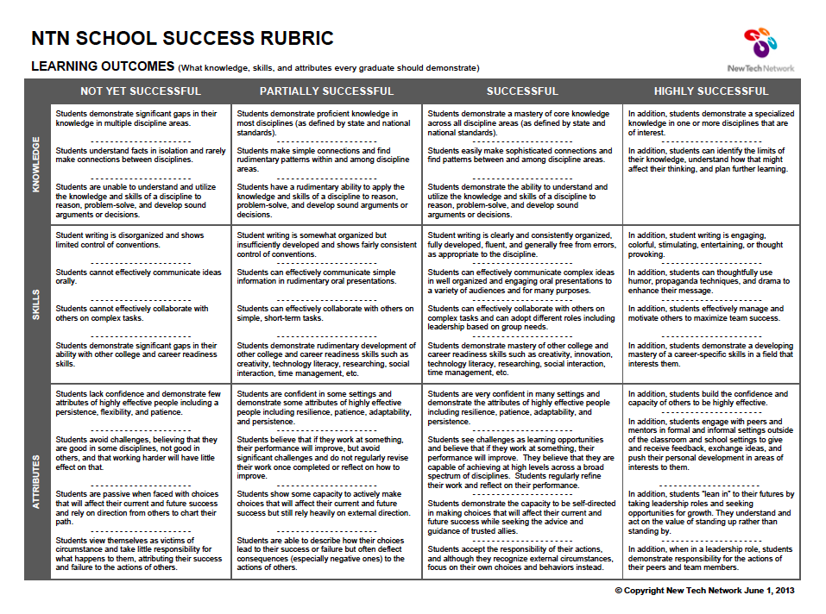
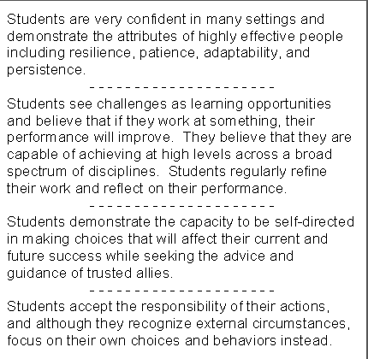
Notes:
Jeff

Slide 13
A Vision for Education in CNY
Teaching that Engages
Culture that Empowers
Technology that Enables
Notes:
Jeff

Slide 14
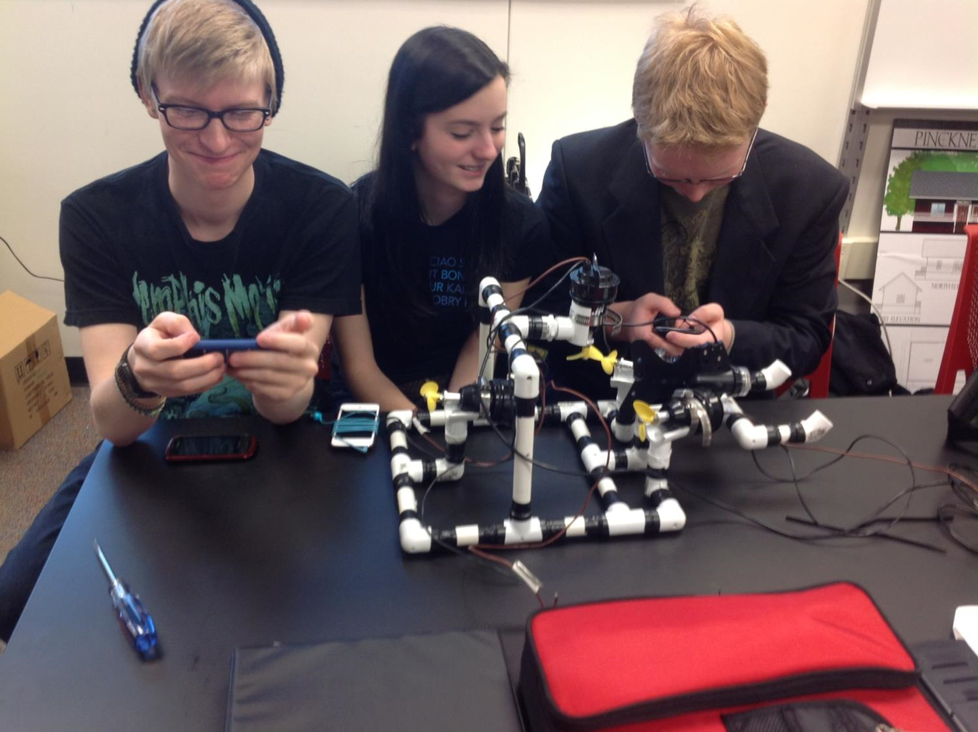
Teaching that Engages
Notes:
Jeff

Slide 15
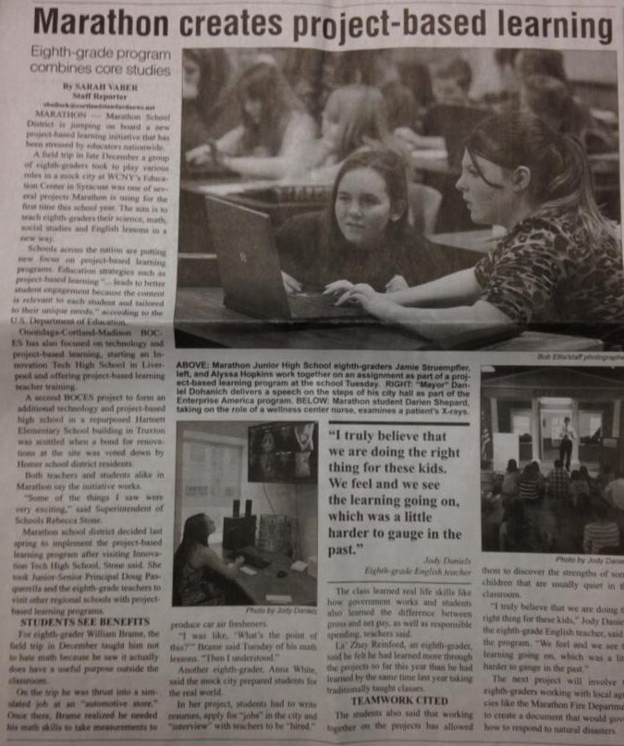
Notes:
Rebecca

Slide 16
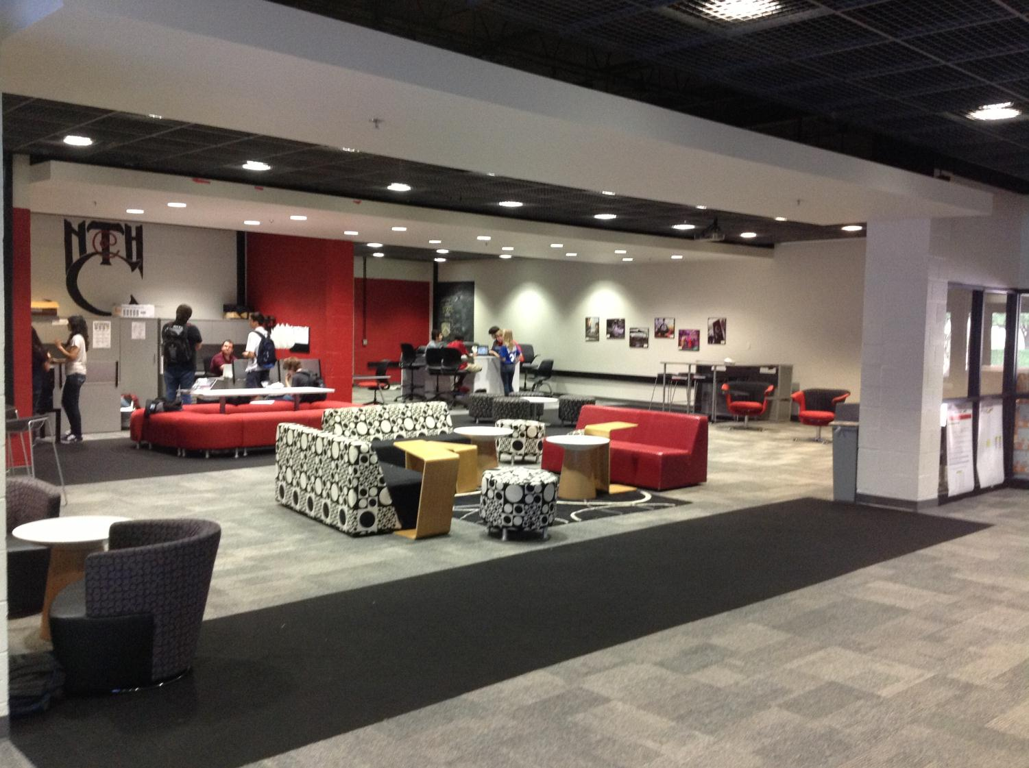
Culture that Empowers
Notes:
Rebecca

Slide 17
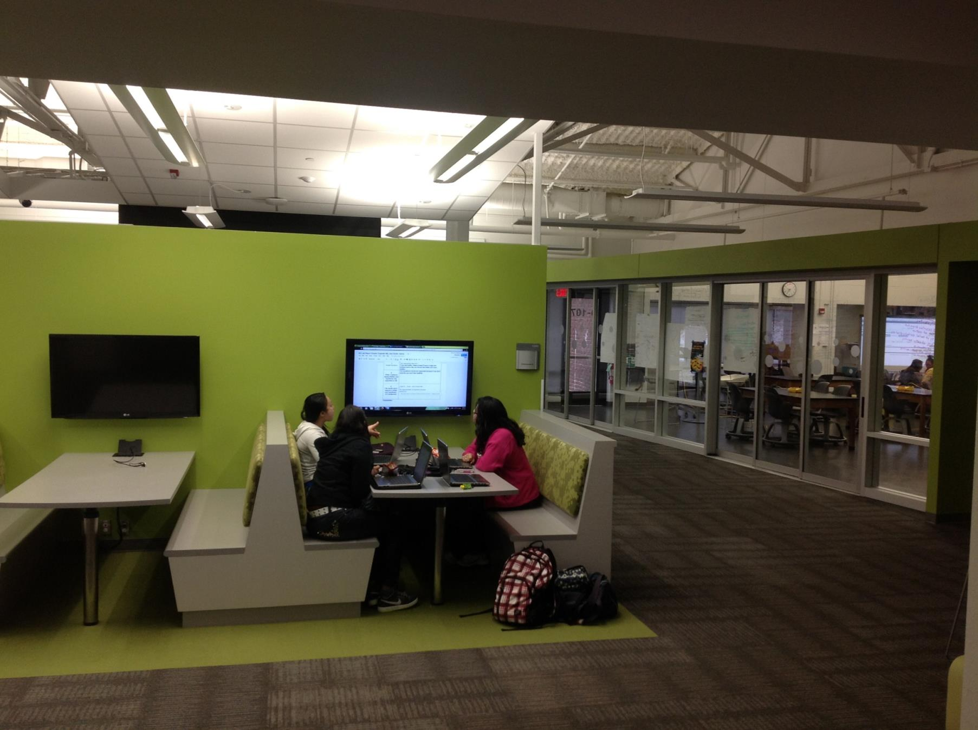
Technology that Enables
Notes:
Rebecca

Slide 18
The Parts of the Regional Vision
Pre-Service Teacher Training
Early College and Dual Enrollment
Professional Development
School:
Visitations
Observation
Training (Buck Institute and NTN)
Coaching
Co-teaching
PBL^{NY}
New Tech Network Model
New Tech High School
Seven Valleys New Tech Academy
(opening September 2016)
OCM BOCES Programs
Innovation Tech at the Career Academy (opened September 2014)
District/School-Based
Integrated PBL Courses
Future School Adoption
Standards (CCLS, NGSS, SS Framework, NYS Teaching Standards, 4Cs, ISTE, etc.)
Business Partnerships
Notes:
Colleen and Jeff

Slide 19
In Schools Now
Team of five trainer/coaches
In-district coaching for [at least] 11 districts and 2 BOCES
More than 1500 educators trained
Leadership support at meetings, dedicated training, and coaching
Notes:
Jeff

Slide 20
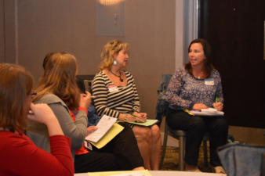
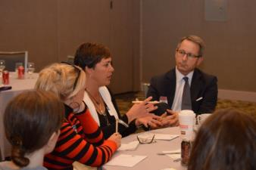
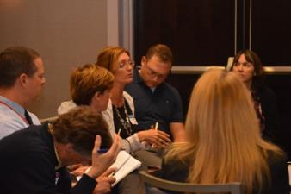
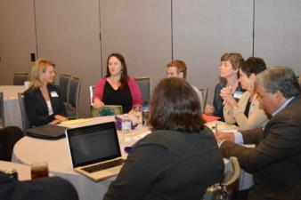
Business & Community Partnerships
“Making Connections” Event
Business share the problems they work on and the projects they do
Teachers “pitch” projects, looking for authenticity and feedback on their projects
Occurs annually
Notes:
Jeff

Slide 21
Teacher Pipeline at
Considering “deeper learning” micro credential
Center of Innovation includes PBL
Supports regional BOCES and P-12 work.
Supports New Tech School Initiatives in region
37 Faculty members at SUNY Cortland have been training in Project-Based Learning and/or Problem-Based Learning
Notes:
Jeff

Slide 22
First “New Tech” High School in CNY
Started with 75 students enrolled in 9th and 10th grade
Will include 11th grade this fall and 12th grade in September, 2016
Districts: Liverpool, North Syracuse, Baldwinsville, Fayetteville-Manlius, East Syracuse-Minoa, LaFayette, Marcellus, West Genesee
Notes:
Colleen

Slide 23
Notes:
Colleen

Slide 24
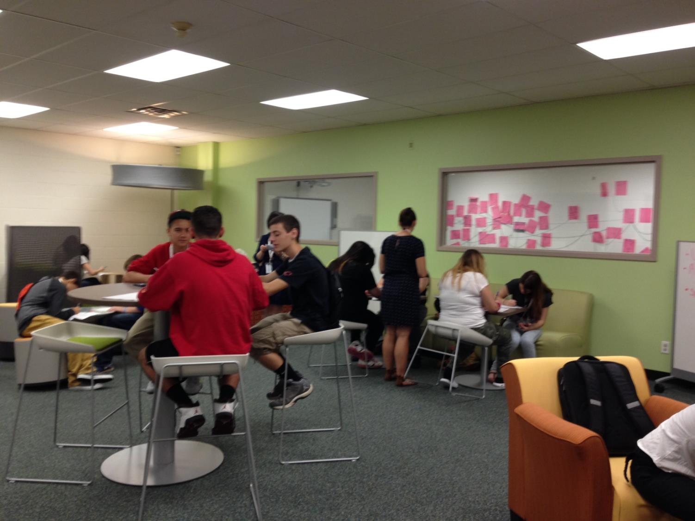
Notes:
Colleen

Slide 25
From an Innovation Tech Student…
Innovation Tech is all about solving real world problems. It is a program that is all about PBL, (Project-Based Learning). The program is a very comfortable work place. We always have something we can be doing and everyone here is there for each other. We learn so much here; from how to solve real world problems to learning everything we need for passing the regent exams. I think all of the students here will be able to pass all the classes and Regents with little to no struggle at all.
-Kelsey Dibernardo, North Syracuse
Notes:
Colleen

Slide 26
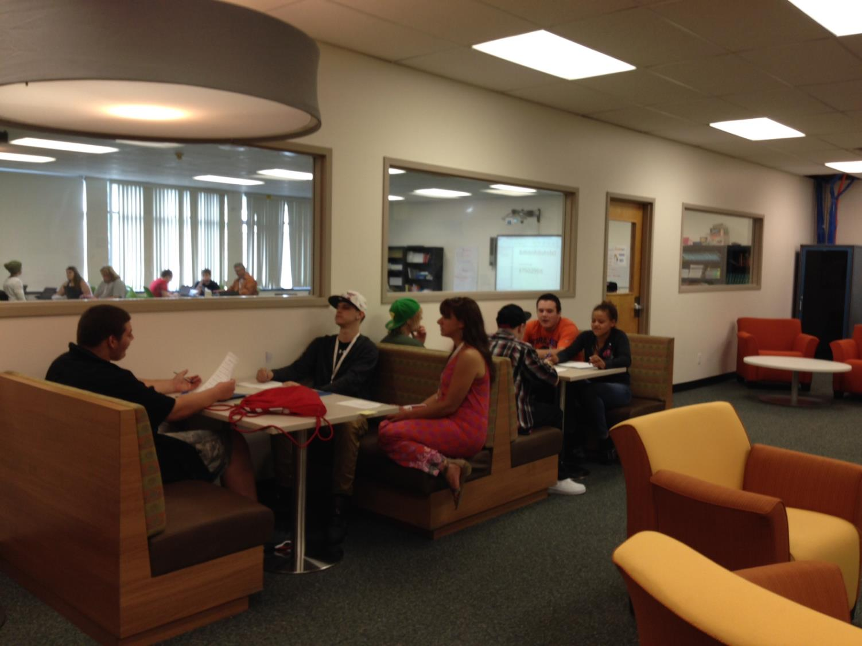
Notes:
Colleen

Slide 27
From an Innovation Tech Student…
Project Based Learning helps me connect what I am learning to the real world and allows opportunities for me to have valuable life experiences. I enjoy working with all of the students in the program to solve problems and to learn from the process. I enjoy the community service portion of the program, but best of all I now have everything I need for my classes at my fingertips both at home and at school. I am able to access my class online and work with my group members even when we are not in school.
-Kevin Campbell, Baldwinsville
Notes:
Colleen

Slide 28
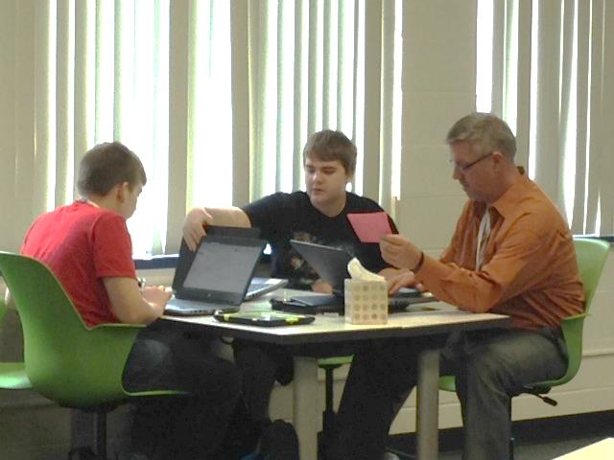
Notes:
Colleen

Slide 29
From an Innovation Tech Student…
Not only is it exciting, but I feel like I’m actually preparing myself for the real world. I am learning several life skills that I would be able to apply in my future, such as how to present to an audience, be professional, collaborate, use technology appropriately, and so many other valuable skills. Before I came to Innovation Tech I did not think very highly about myself or my future. Now I want to become a psychologist and am confident I will!
-Katie Asbury, Liverpool
Notes:
Colleen

Slide 30
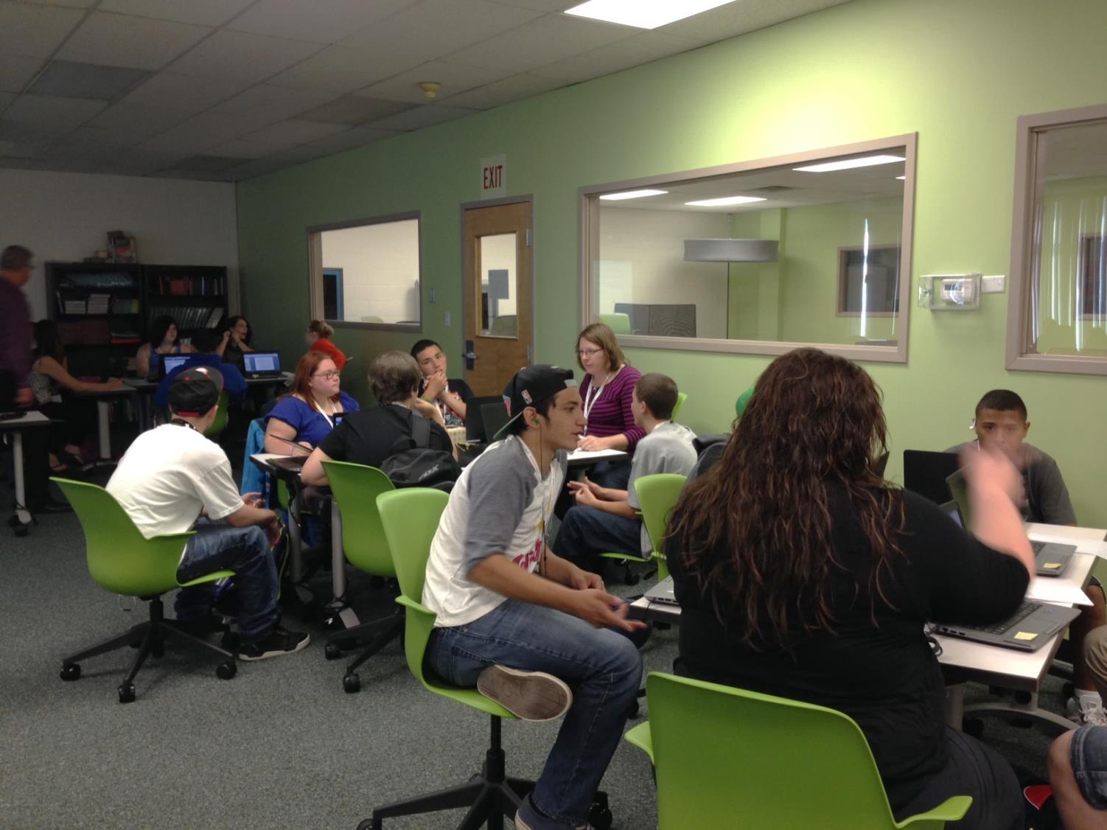
Notes:
Colleen

Slide 31
Course Offerings 2015-2016
9th Grade | 10th Grade | 11th Grade
Innovation Tech 101 | Global Lit | GeoDesign*
Algebra | Earth Comm | American Lit*
Bio Lit | GeoDesign* | Contemporary Chemistry
Global Arts | Wellness & Spanish* | Wellness & Spanish*
Spanish I | Read 180 | Physical Education
Read 180 | Sociology | Health
Current World Events | Physical Education | People, Places & Employment
Physical Education
Courses marked with * can earn college credit
Notes:
Colleen

Slide 32
Other Integrated Courses
Algebra 1/ Intro to Engineering and Design
Visual and Verbal Communication
EnviroCom
Biology I & Introduction to Agriculture
BioFitness
Food and Modern Chemistry
Digital Literacy
Ecological Economics
Geometry/Introduction to Engineering & Design
Integrated World Studies
Literacy in Participation in Democracy
Consumer Communications
The Nature of Science and Technology
Environmental Analysis
Impact of Science on World History
The Science of Physical Education
Humanities 9/Big History
America's Story
Operations Research
WorldLit
Literature and Legacies II
Nutrition and Wellness
Student Leadership
Zoology
Combined Algebra I & Physical Science
Notes:
Nancy

Slide 33
New Tech Comes to Cortland
Opening September 2016
Beginning with grades 9 & 10 with 50 learners
Adding grades 11 & 12 in subsequent years
Full enrollment of 100 learners
Districts: Cincinnatus, Cortland, DeRuyter, Homer, Marathon, McGraw, Tully (and potentially more)
Notes:
Rebecca

Slide 34
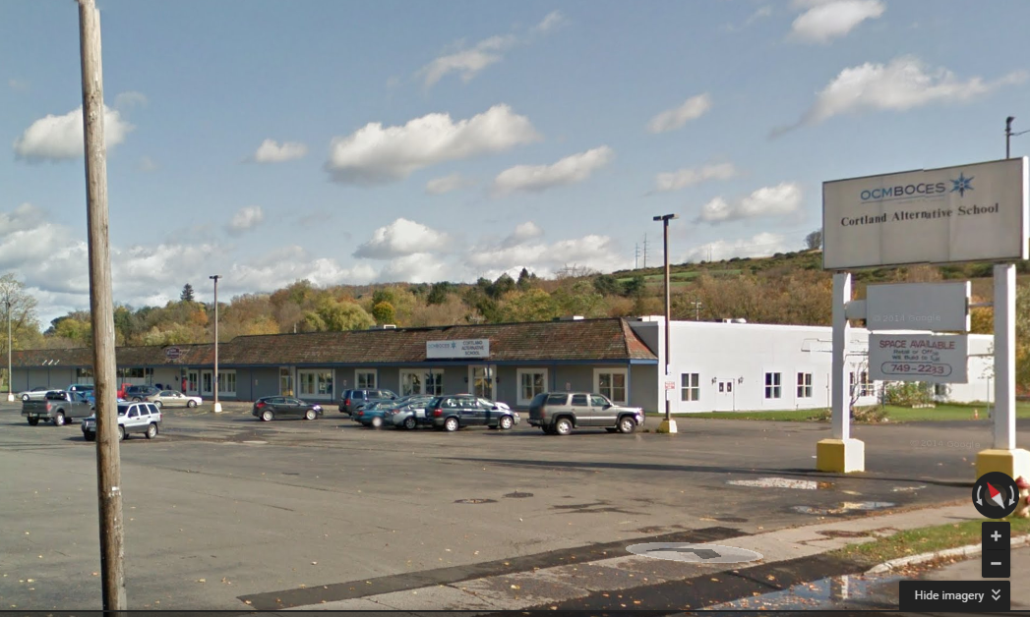
Seven Valleys
Fadden & Associates Physical Therapy
Cortland Alternative School
240 Port Watson St
Notes:
Rebecca

Slide 35
Key Qualities of a New Tech School
Teaching that Engages
Culture that Empowers
Technology that Enables

Slide 36
See it for Yourself at Innovation Tech
Tours are from 9-10:30 am at the Innovation Tech Campus (4500 Crown Road, Liverpool)
November 12
December 10
January 14, 2016
February 11, 2016
March 3, 2016
April 14, 2016
May 12, 2016
June 2, 2016

Slide 37
Information Meetings
December 9th
McEvoy 701
Innovation Tech students tell their story
Innovation Tech teachers explain how it works
Visits for families to Innovation tech
An additional meeting will be scheduled

Slide 38
Questions & Answers

